Slide 1
Slavery and Race in British North America

Slide 2
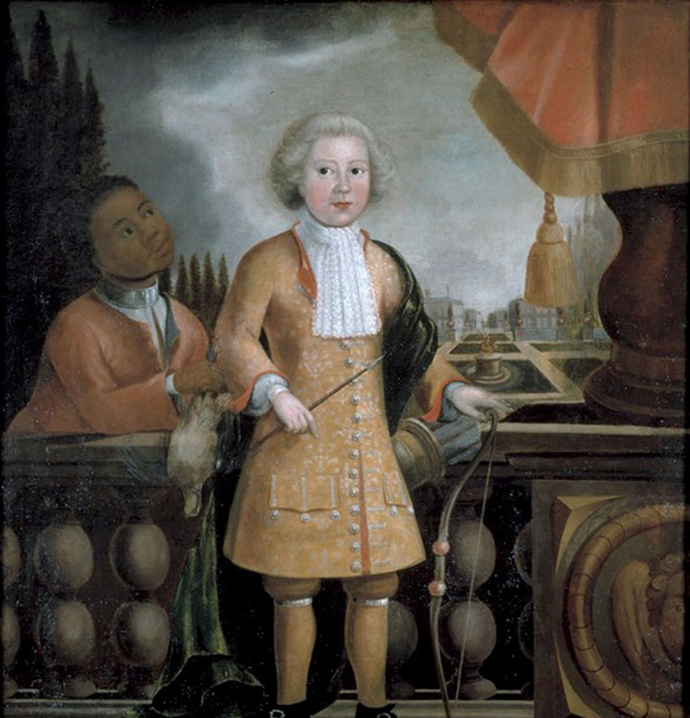
Charter Generations
Societies with slaves
Marginal to economy
One form of labor among many
Slave societies
Primary labor system
Master-slave relationship
Not a uniform process, moves in both directions
Black and white labor equal

Slide 3
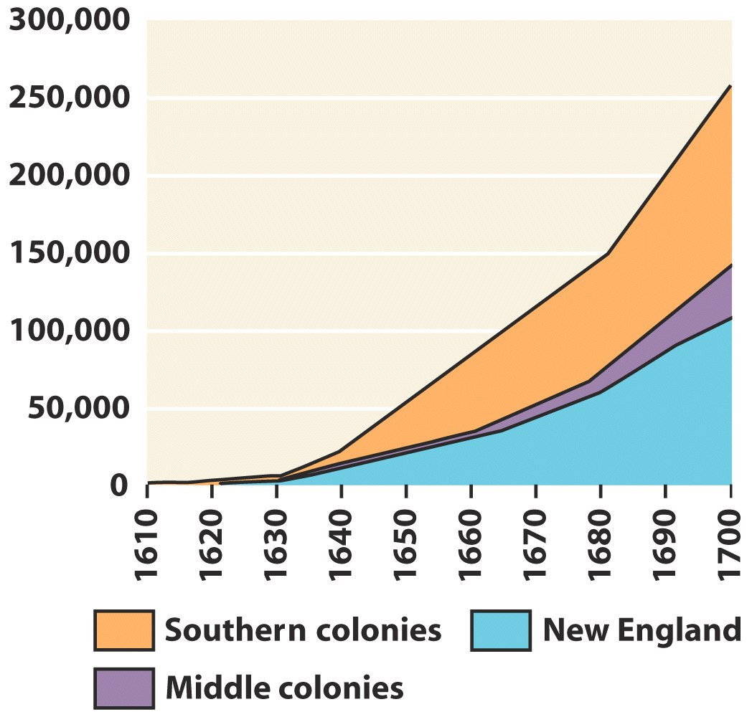
Why does slavery supplant white labor?
Immigration
Mortality rates
Land
Staple crops

Slide 4
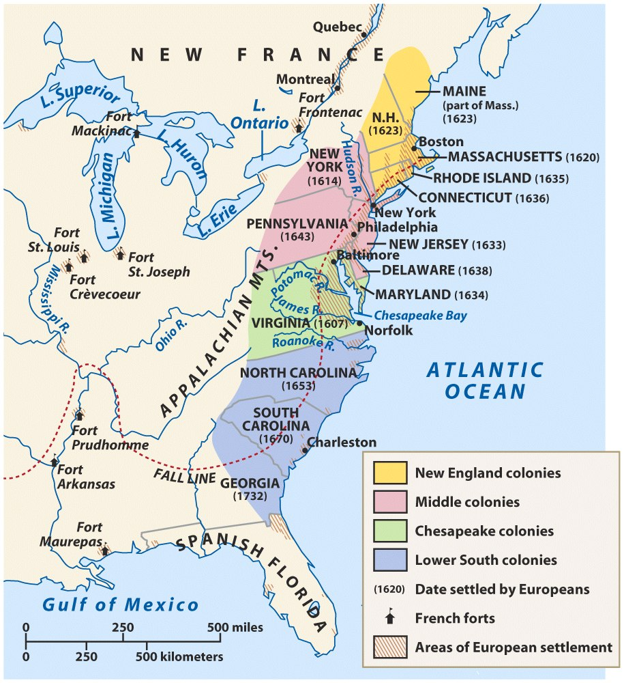
Plantation Revolution
North
Small farms, food crops
Chesapeake
Maryland and Virginia
Tobacco
Low Country
South Carolina
Rice and indigo
Lower Mississippi Valley
French/Spanish
Sugar

Slide 5
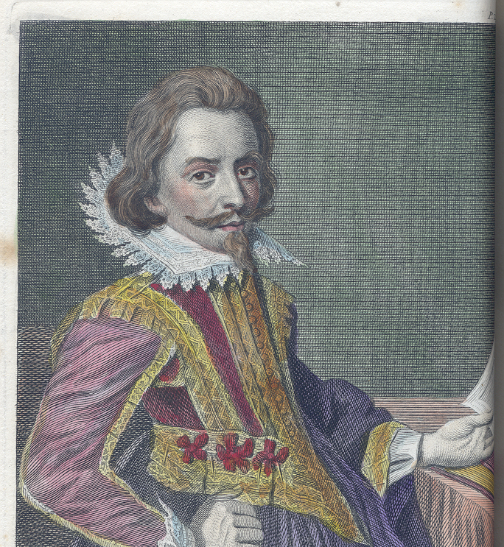
Chesapeake
Indentured servants
Headright
Treaty of 1646
Bacon’s Rebellion
Facilitated labor transition
Notes:
Indentured servants
headright
Treaty of 1646
Indian land
Bacon’s Rebellion
summer 1675
security, land
Gov. Berkeley
Jamestown burned
Facilitated labor transition

Slide 6
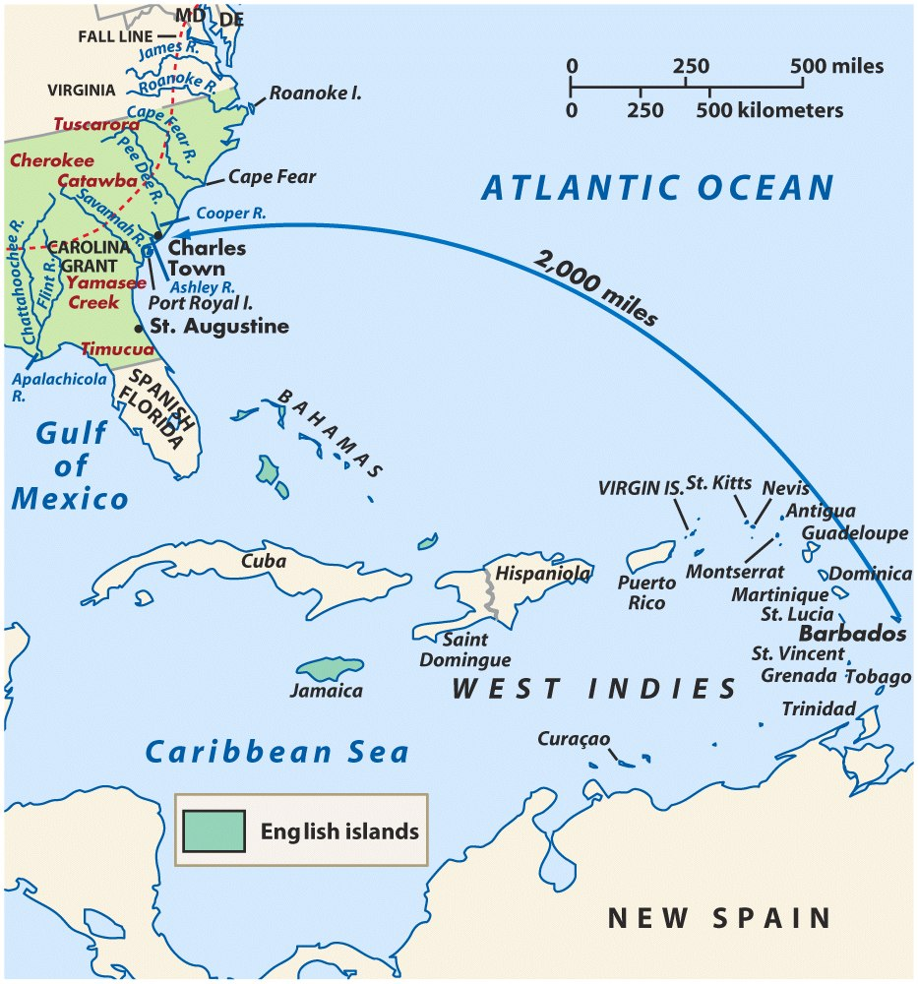
Low Country
Barbadian settlers
Supply colony
Staple crops
Black majority
Notes:
Barbadian settlers
Supply colony
Livestock
Indian slaves
Staple crops
Rice, indigo
Black majority
Absentee owners
Gullah dialect
Maroon communities

Slide 7
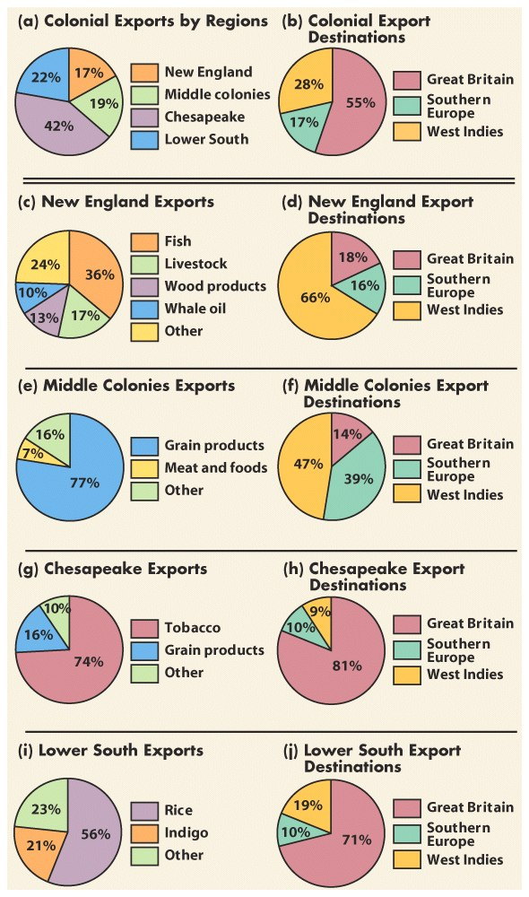
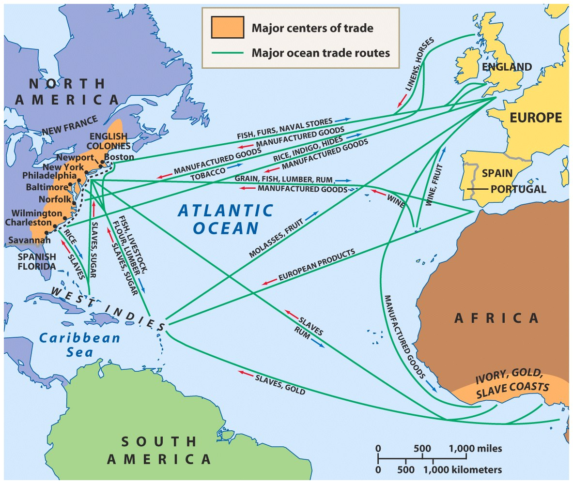
Atlantic World Economy

